Slide 1
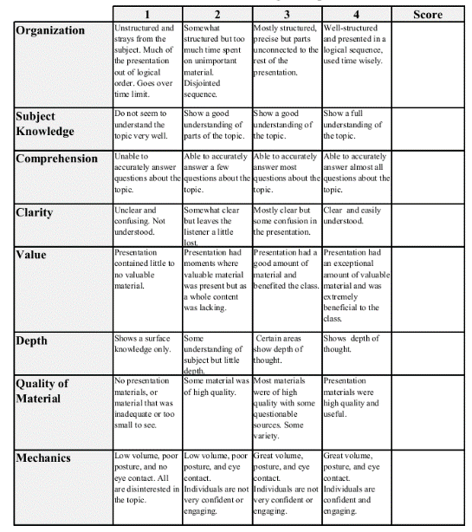
Fall 2013: Econ 339 Final Presentation
Thomas Martino
Dec 4 2014
Mergers and innovation…
Reference: W.S Comanor, F.M. Scherer/Journal of Health Economics 32(2013) 106-113
Total:_________

Slide 2
Mergers and innovation in the pharmaceutical industry
By: Tom Martino

Slide 3
Pharmaceutical Industry and Innovation
“Conlicting trends confound the pharmaceutical industry”(Comanor)
Massive productivity shock
What is the effect of these shocks?
The merger wave
Have these companies started a self defeating strategy?

Slide 4
Uncertainties and Parallel Paths
What are parallel paths?
Parallel path strategies depend on two conditions
What are the phases these drugs go through?
How is there uncertainty within these phases?

Slide 5
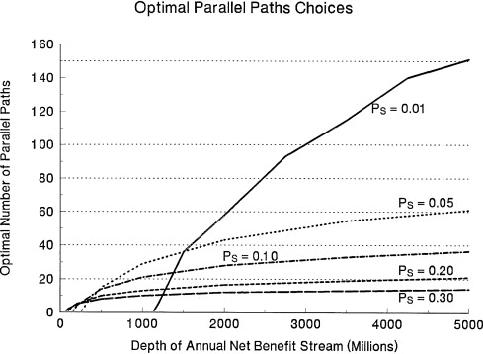
Profit Maximizing
t
Max∫ HPSNQ(t)e−rtdt−NC(RD)
s

Slide 6
The Evidence
Researchers focused on the leading five pharmaceutical companies
Phase II and III
There is an alternative hypothesis that cannot be ruled out
“Companies fail to appreciate the full merits of parallel paths and/or view parallelism as a form of wasteful ‘duplication’”(Comanor)

Slide 7
What does this mean for the industry?
Society benefits from research and development tend to exceed private benefits
Rate of Return
Is there a problem in the market?
Size of companies
Marketing capabilities
Where are these smaller companies getting there money?

Slide 8
Conclusion
Their conclusions were not definitive, but rather speculative
Evidence is there to support parallel paths and uncertainty cause mergers, and vice versa
All in all, recent mergers have contributed to to the decline of pharmaceutical innovation

